Slide 1



SC1015
MINI
PROJECT
Yi Jing, Si Yao, Yee Xi

Slide 2









FRAMEWORK
Practical Motivation
Intelligent Decision
Problem Formulation
Statistical Inference
Statistical Description
Machine Learning
Pattern Recognition

Slide 3


PRACTICAL MOTIVATION
Covid 19 has caused disruption in many aspects of our lives
Notes:
Covid 19 have cause disruption in many aspect of our lives eg economic growth , financial sector, healthcare sector, social connections..etc. As it now becomes an endemic from a pandemic, we are now reflecting on how we can better manage future diseases that may have an effect comparable to covid19. Thus the datasets we used was from the
Coronavirus Pandemic (COVID-19) - Our World in Data. We used the data set of US regarding the weekly positive cases, weekly deaths, total vaccinations and daily hospital occupancy

Slide 4


PROBLEM FORMULATION
What are the factors that affect the number of deaths?
Can the number of deaths be reduced?
Notes:
We would like to analyse the different factors that may affect the number of deaths due to covid19. And forecast the total number of deaths in order to reduce future deaths.

Slide 5

DATA SET
Coronavirus Pandemic (COVID-19) - Our World in Data
Predictors:
Weekly positive cases
Total Vaccination
Daily hospital occupancy
Response:
Weekly Deaths
Notes:
Based on the data set

Slide 6
DATA CLEANING
Common dates : 13 Dec 2020 - 9 May 2023
Country seleted to anaysis: United States
aligning datasets according to the exact dates -> may not accurate
e.g. testing positive for covid does not imply dying on the same day
To accommodate for the shifting of the predictors: common dates : 17 Jan 2021 - 9 May 2023

Slide 7
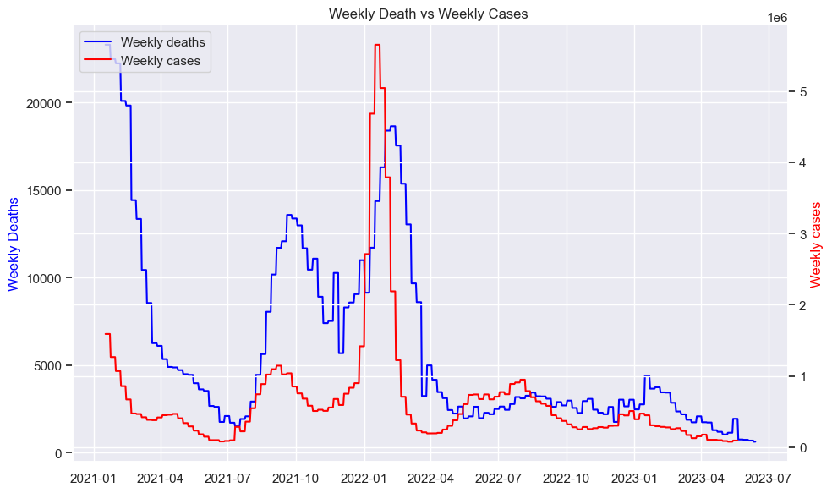
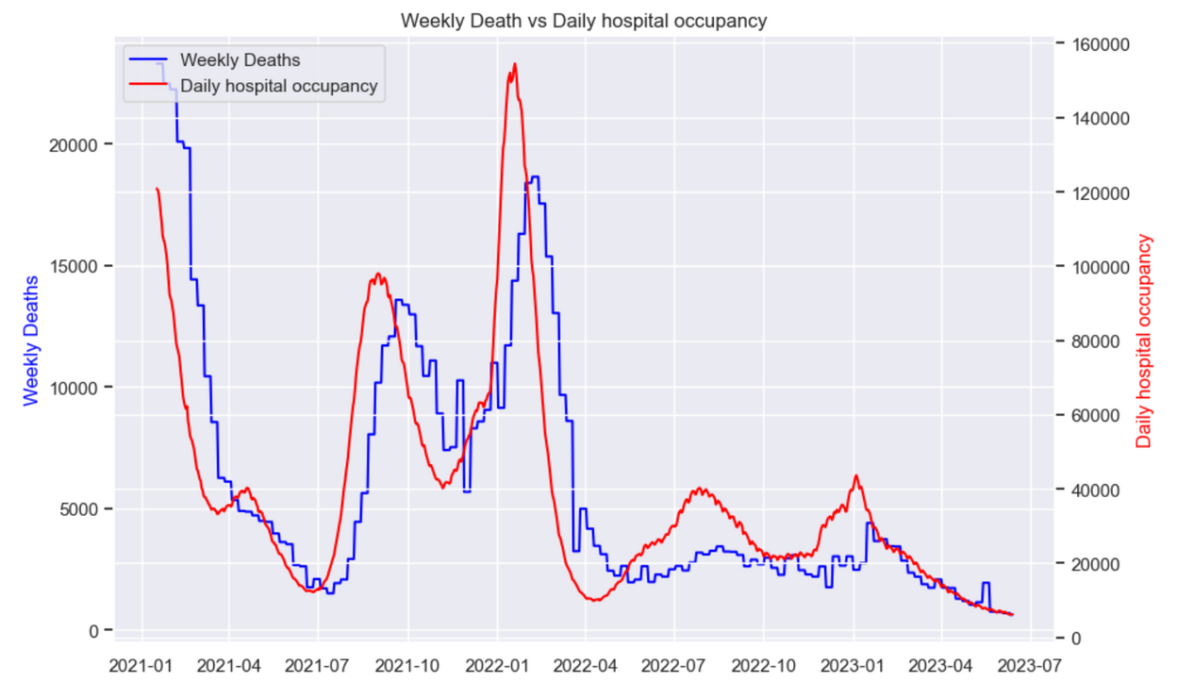

TIME SERIES
Weekly deaths vs Weekly Cases
Weekly deaths vs Daily Hospital Occupancy

Slide 8
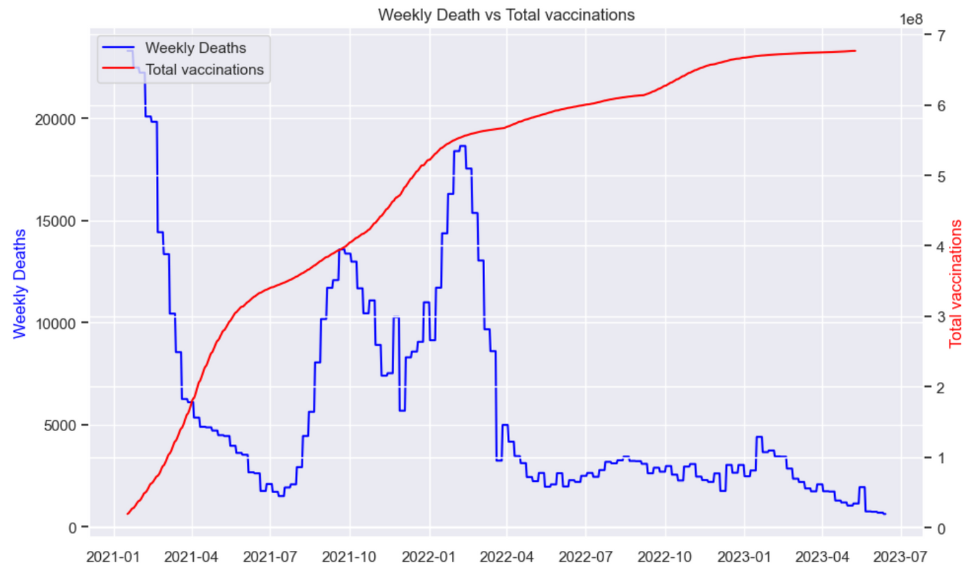

DATA CLEANING
Weekly deaths vs Total vaccinations

Slide 9

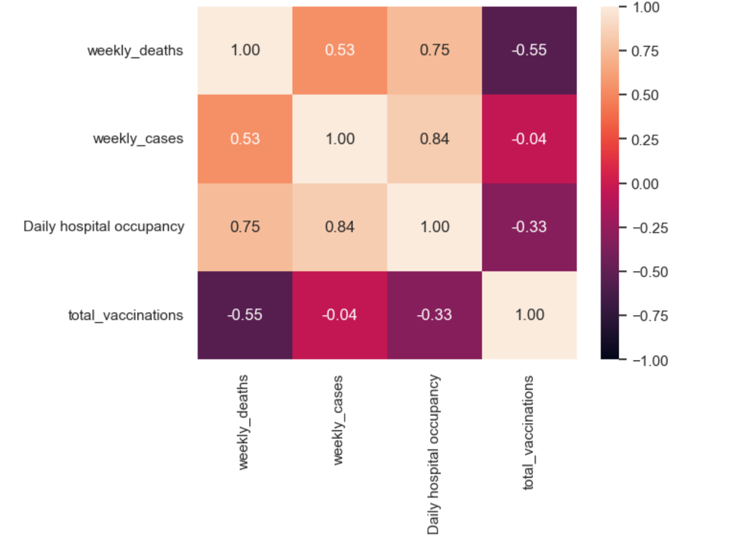
Correlation using Heatmap

Slide 10

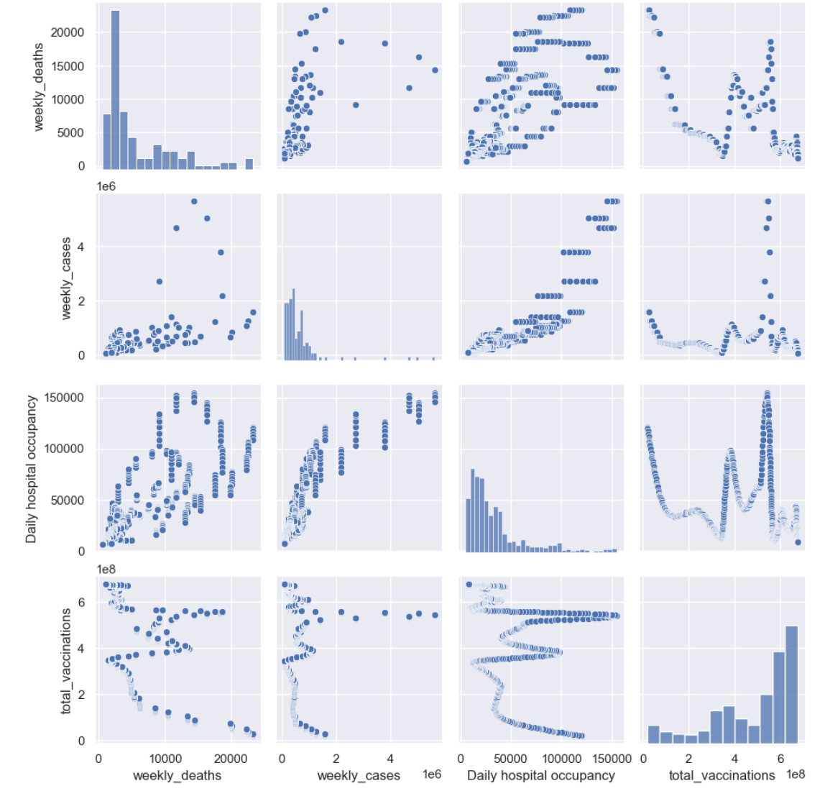
PAIR PLOT

Slide 11
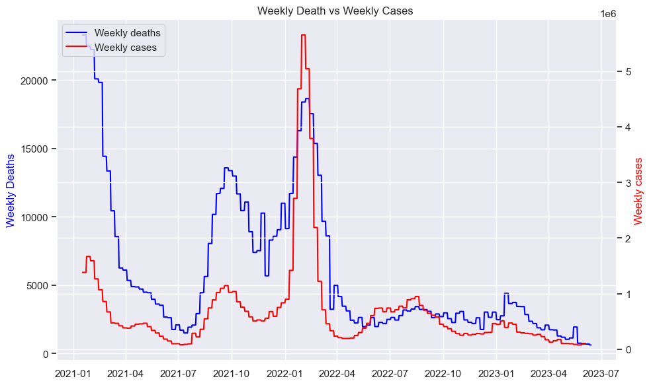


DATA MANIPULATION
Weekly deaths vs weekly cases
Week 2 Shift
Week 3 shift

Slide 12

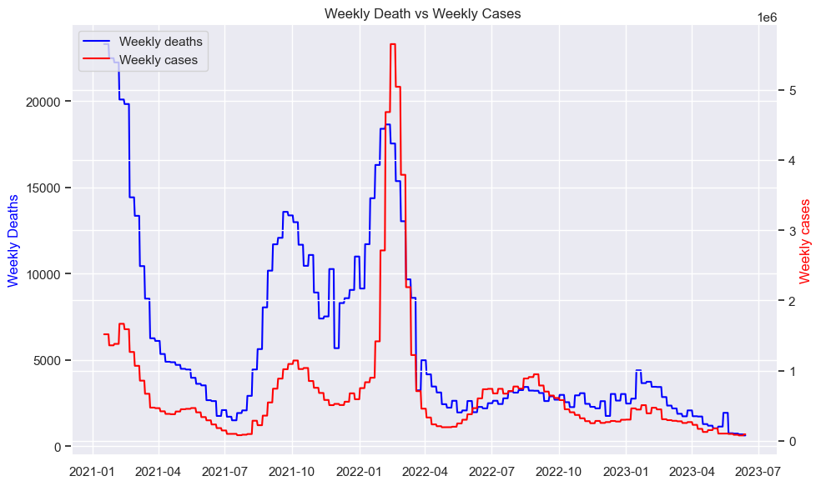
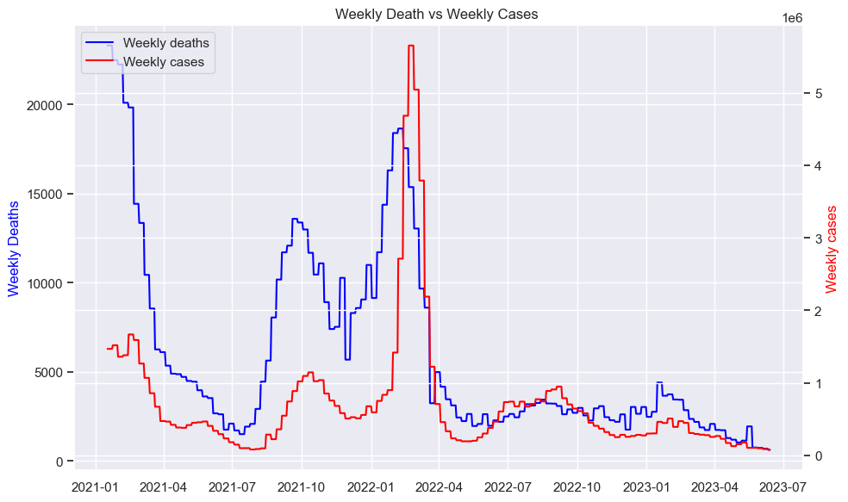
DATA MANIPULATION
Weekly deaths vs weekly cases
Week 4 Shift
Week 5 shift

Slide 13
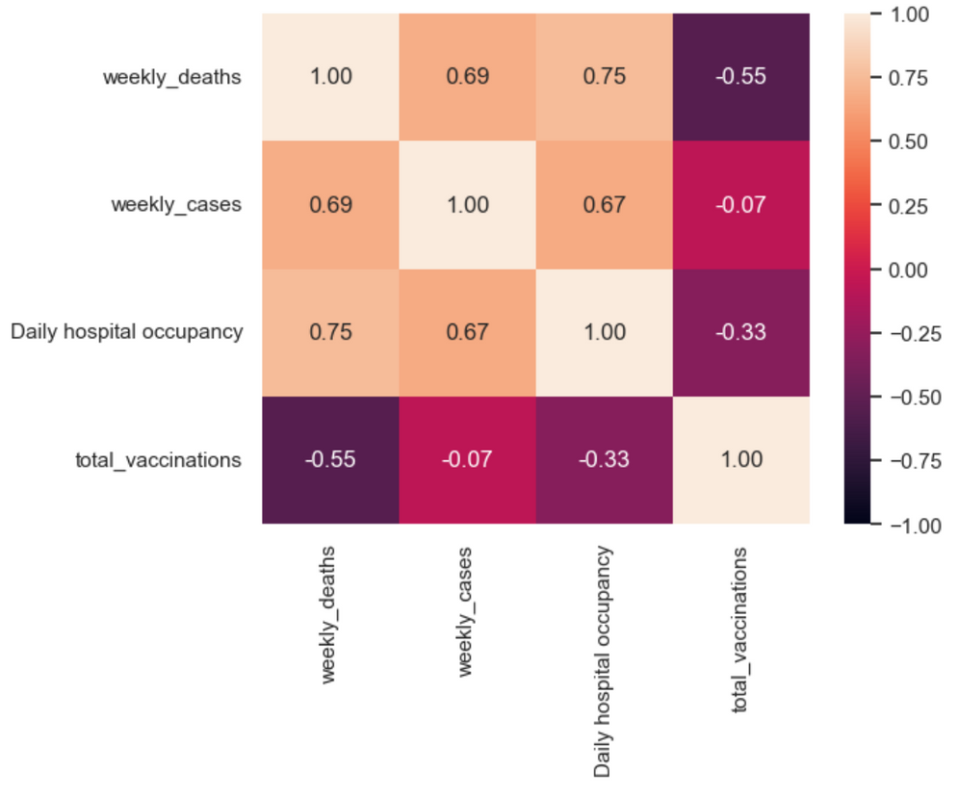
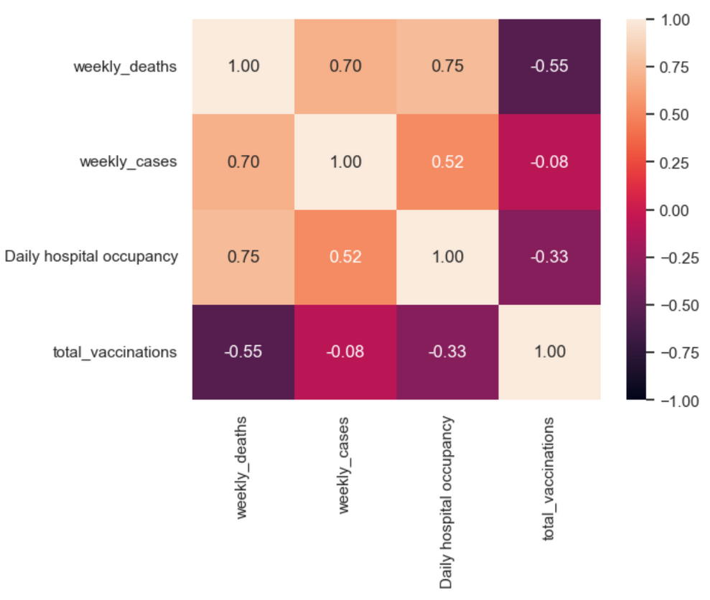


STATISTICAL ANALYSIS
Week 2 shift
Week 3 shift

Slide 14
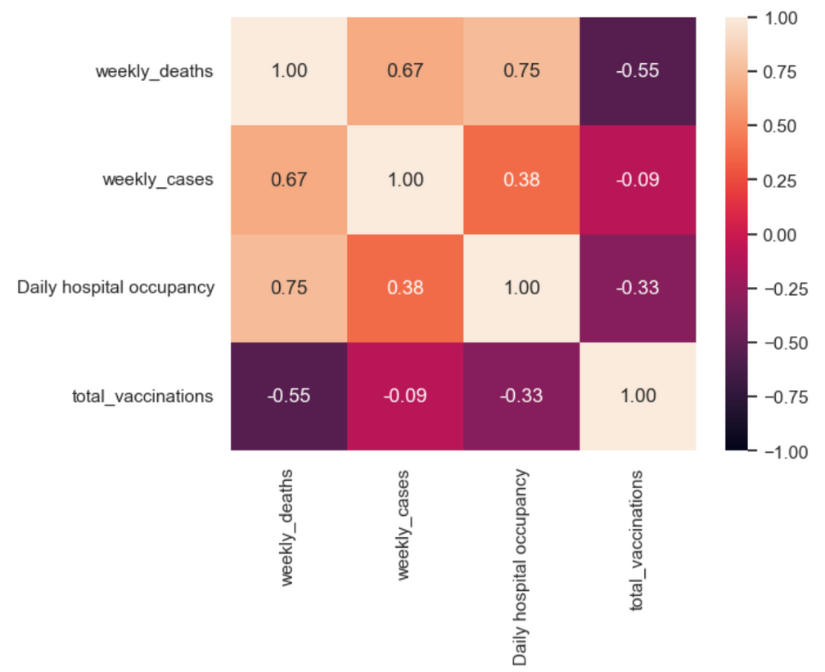
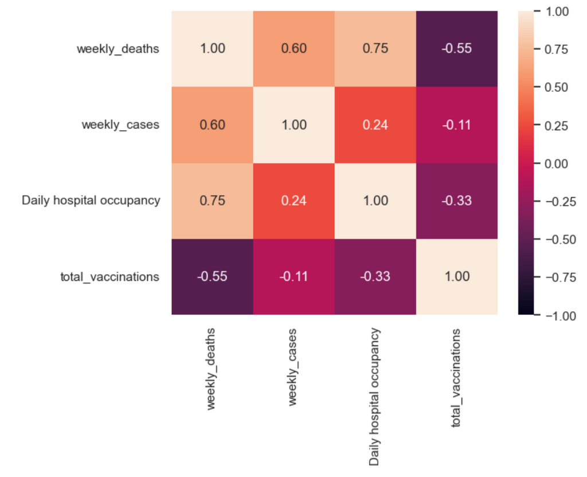
STATISTICAL ANALYSIS
Week 4 shift
Week 5 shift

Slide 15
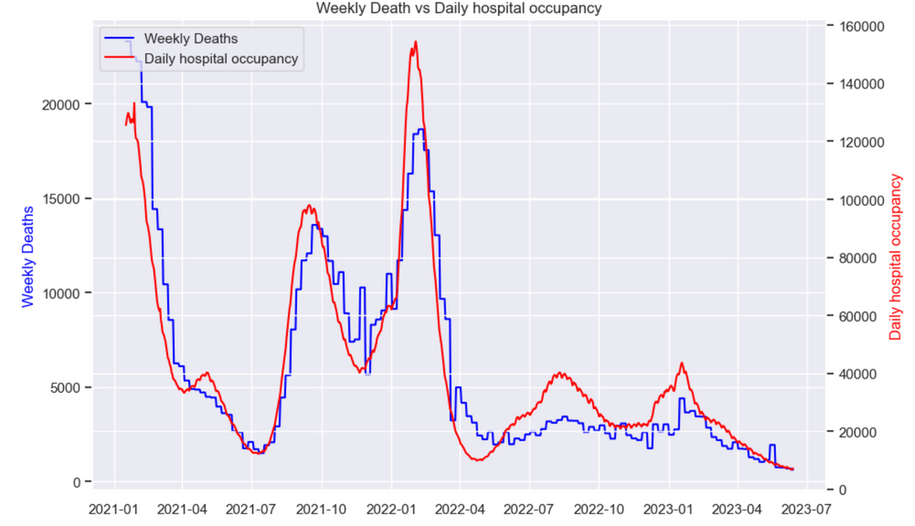
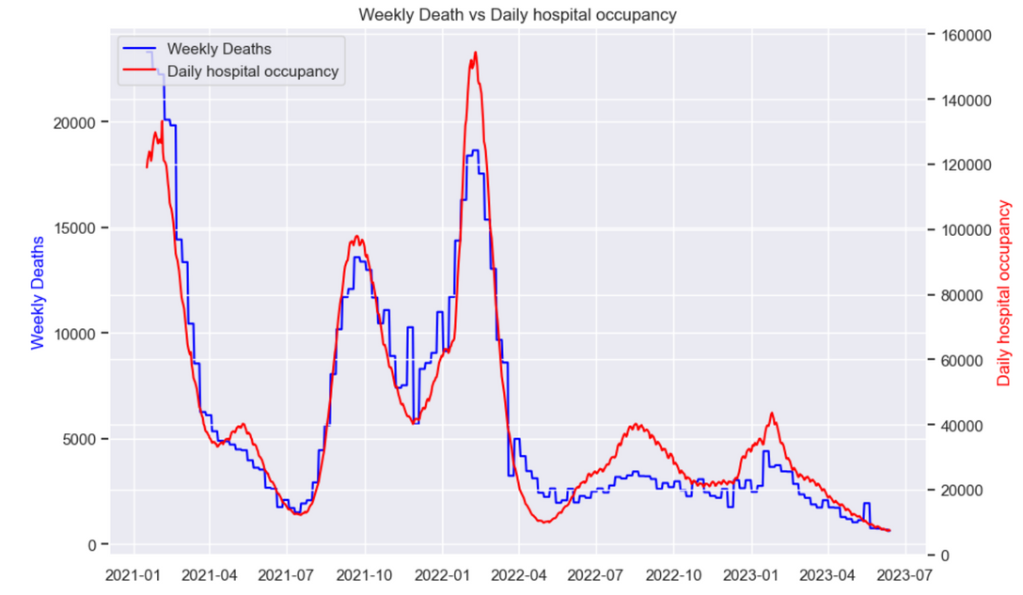
DATA MANIPULATION
Weekly deaths vs Daily hospital occupancy
Week 2 Shift
Week 3 shift

Slide 16

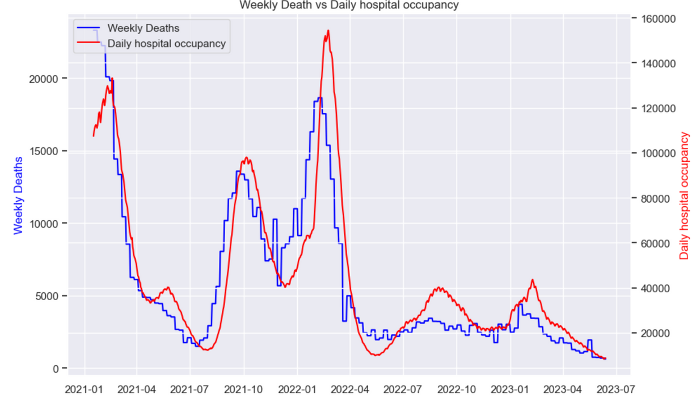
DATA MANIPULATION
Weekly deaths vs Daily hospital occupancy
Week 4 Shift
Week 5 shift

Slide 17
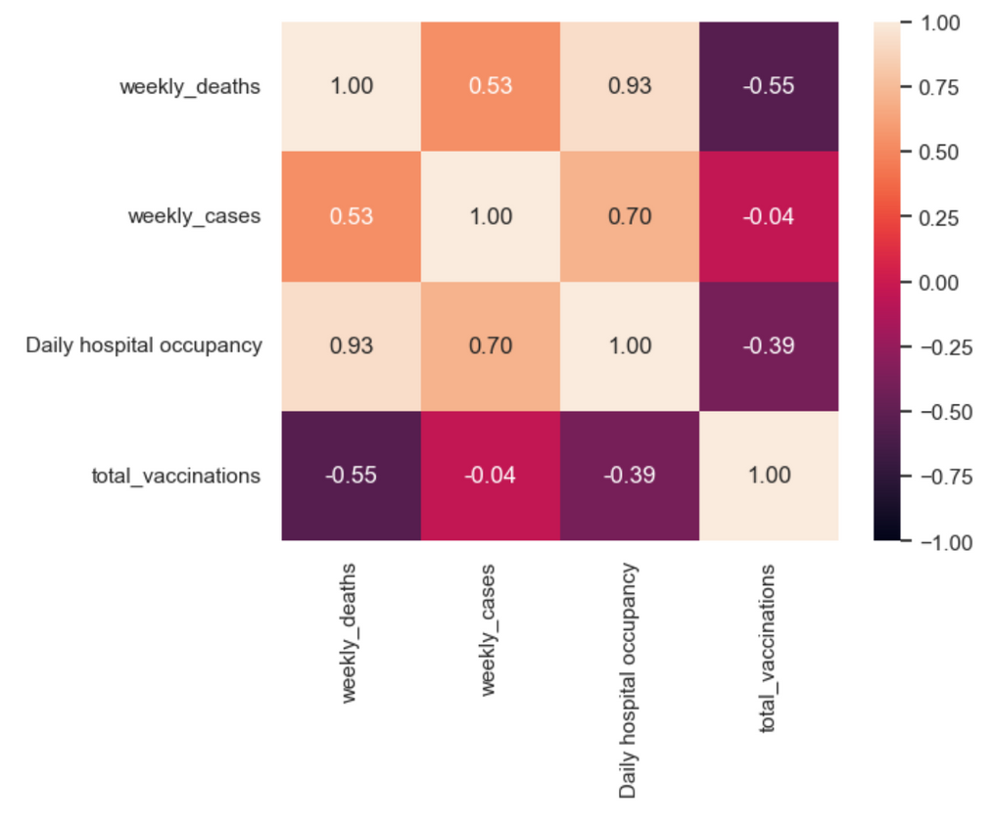
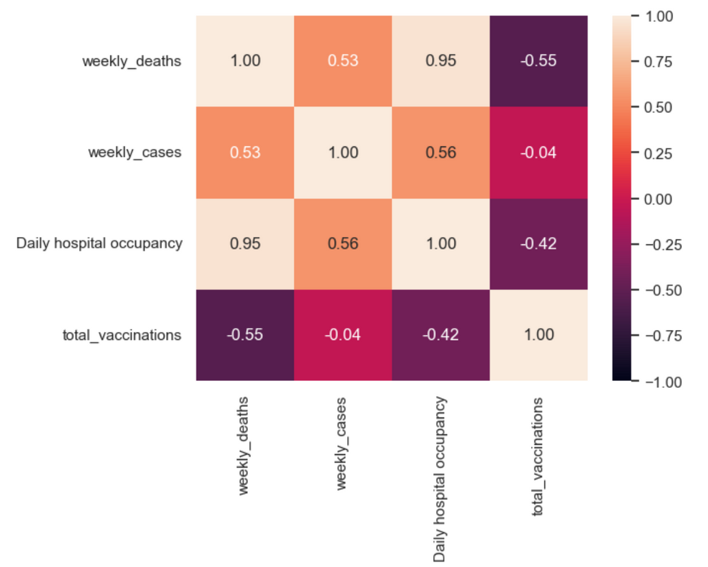
STATISTICAL ANALYSIS
Week 2 shift
Week 3 shift

Slide 18
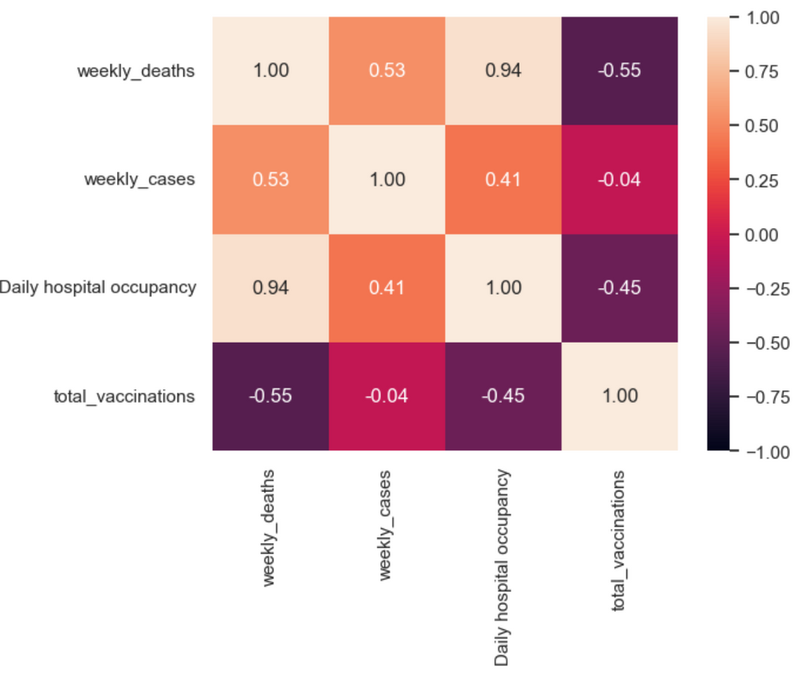
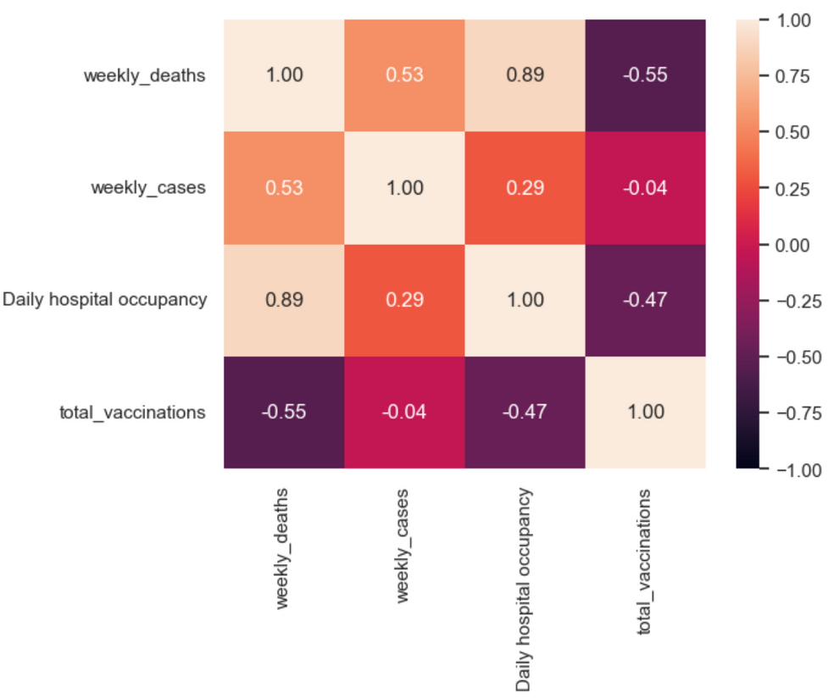
STATISTICAL ANALYSIS
Week 4 shift
Week 5 shift

Slide 19
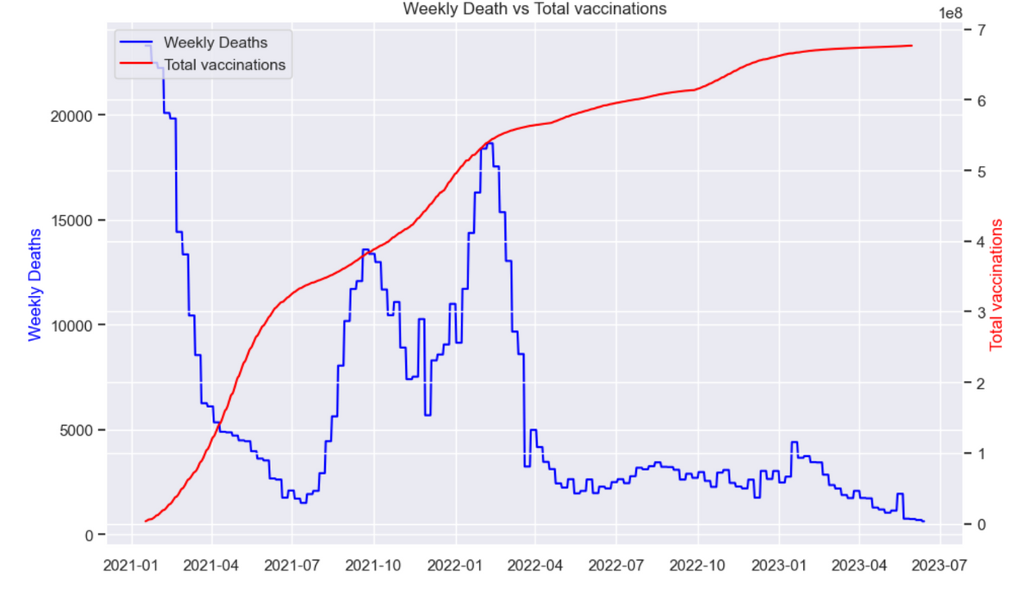
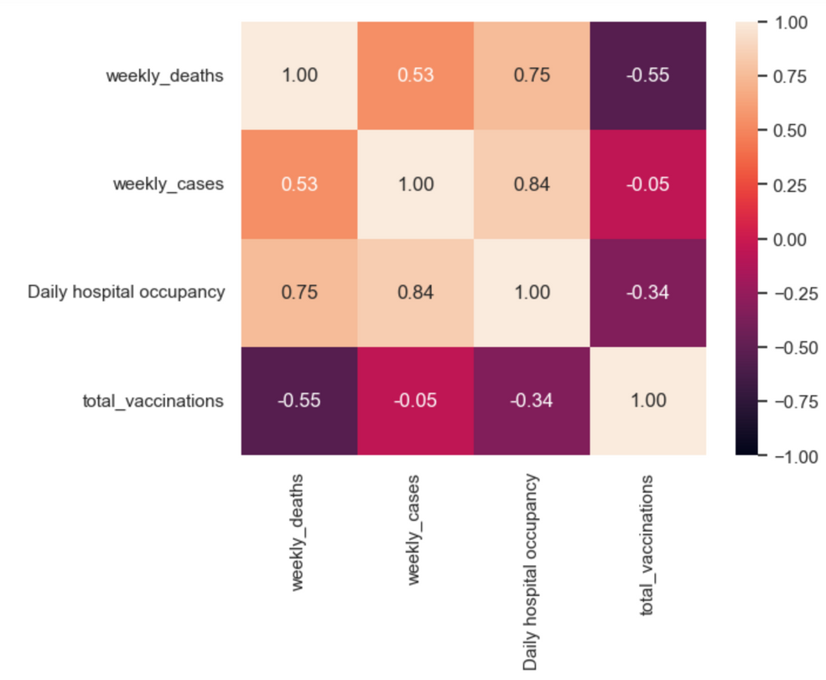
STATISTICAL ANALYSIS
Weekly deaths vs Total vaccinations
Week 3 shift
Week 3 shift

Slide 20


REGRESSION
MULTIVARIATE
REGRESSION
LINEAR REGRESSION
A multivariate linear regression model would have the form. where the relationships between all our predictors and our response (death) are assessed.
Linear regression is an algorithm that provides a linear relationship between one of our predictors and our response to predict the number of death in the future

Slide 21
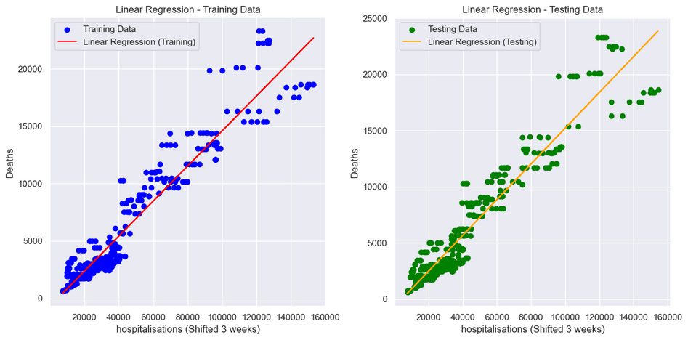
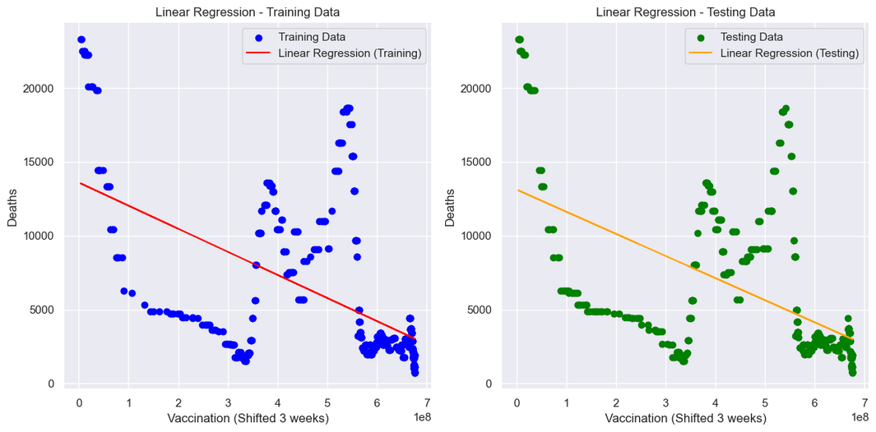
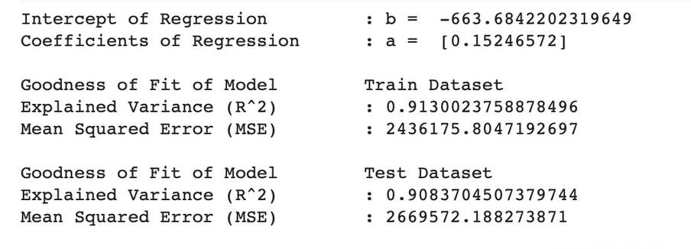
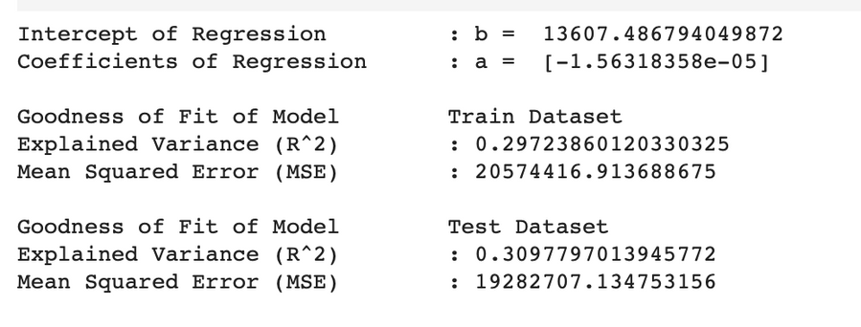
LINEAR REGRESSION
Hospitalisation (Shift 3 Week)
VACCINATION (SHIFT 3 WEEK)

Slide 22
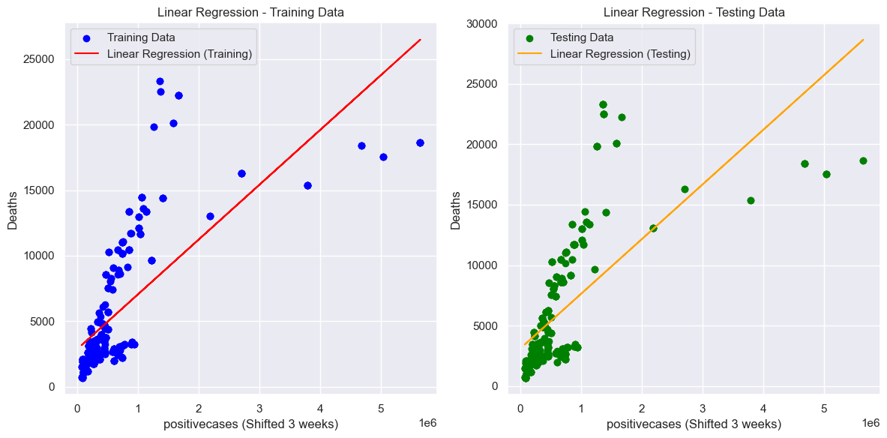
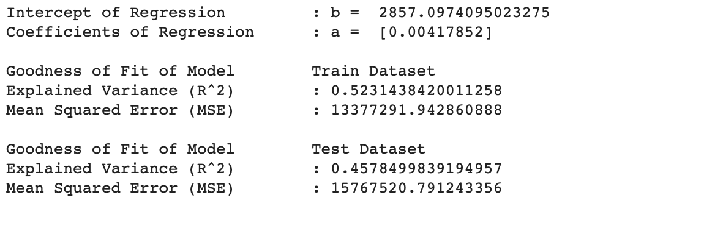
LINEAR REGRESSION
Positive Cases (Shifted 3 Weeks)

Slide 23
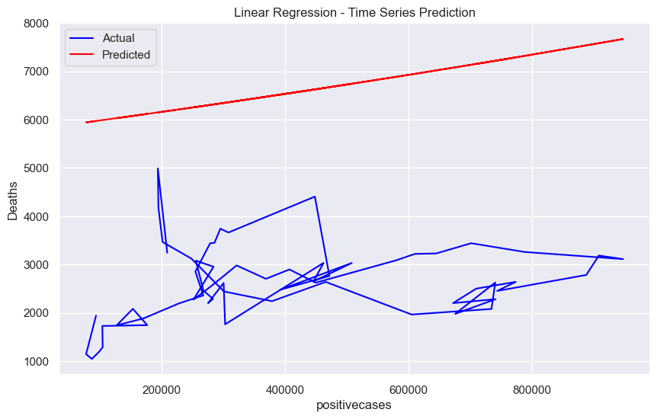
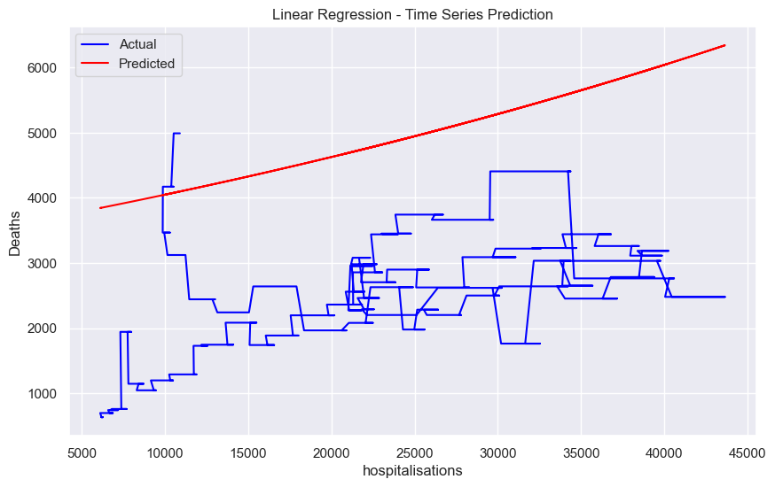
PREDICTION
Positive Cases
Hospitalisation

Slide 24
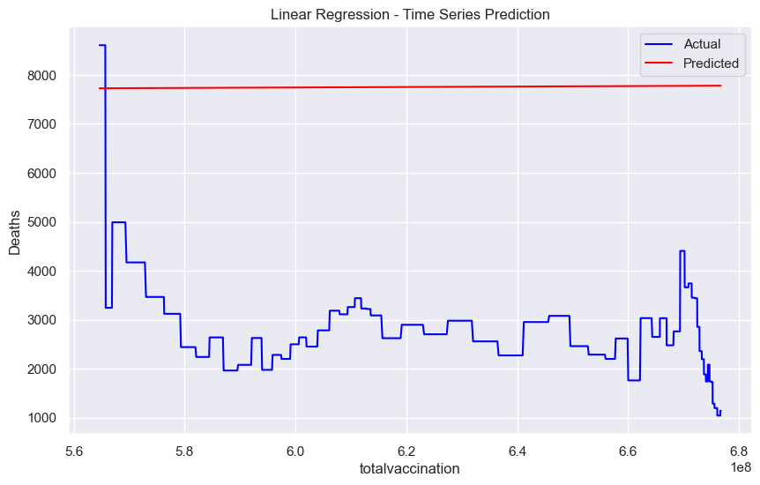
PREDICTION
Vaccination

Slide 25
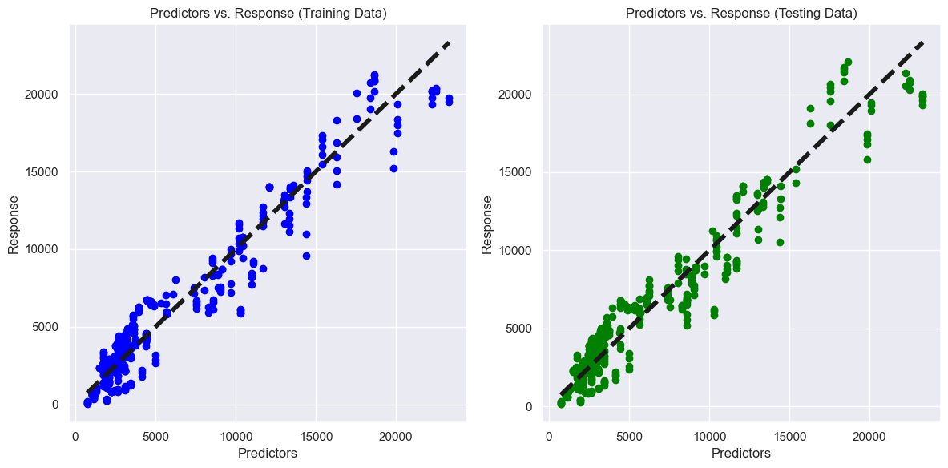
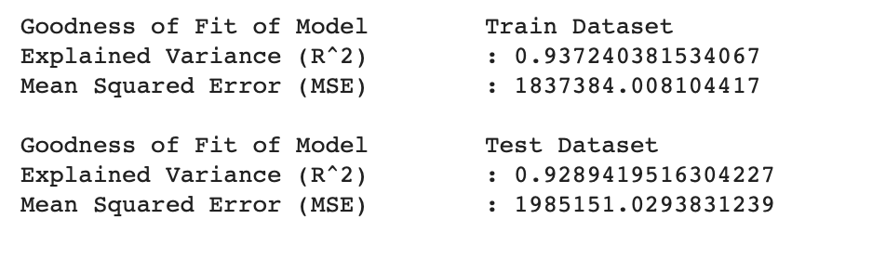
MULTIVARIATE Regression

Slide 26



OUR RECOMMENDATION
MAXIMISE THE NUMBER OF VACINATION
MONITOR YOURSELF FOR MORE THAN 3 WEEKS IF GOT COVID POSITIVE
ISOLATE YOURSELF MORE THAN 3 WEEKS

Slide 27
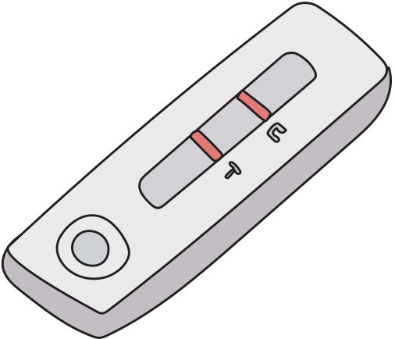

THANK YOU!
FOR YOUR ATTENTION

